Slide 1
SOLELY FOR PURPOSES OF FORAGE WORK EXPERIENCE
Predicting Customer Buying Behaviour British Airways

Slide 2
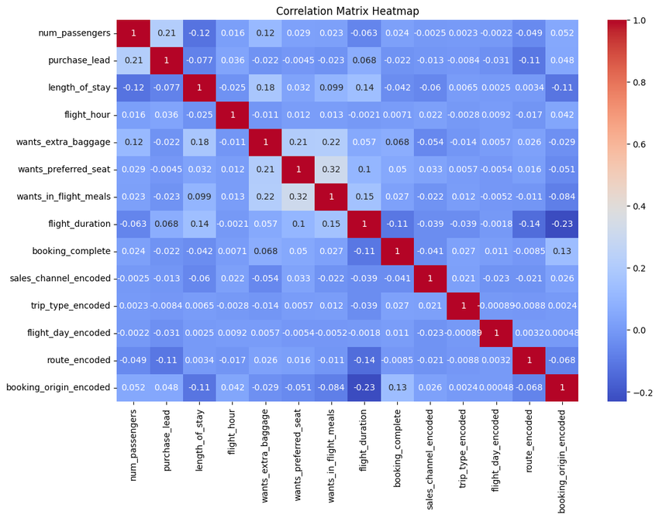
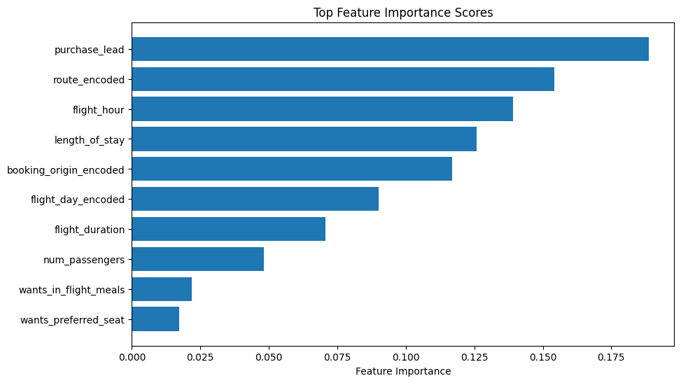
SOLELY FOR PURPOSES OF FORAGE WORK EXPERIENCE
Model Evaluation Metrics:
Accuracy: 0.98214
Feature Insights:
purchase_lead is the most important feature for predicting the outcome, indicating that the lead time for purchase significantly influences the model's predictions.
route_encoded, flight_hour, and length_of_stay are also important contributors to the model's accuracy.
Other features, such as sales_channel_encoded and trip_type_encoded, have lower importance but still contribute to the model's performance.
Feature Importance:
The model has been trained on the following features, and their respective importance scores are visualized in the heatmap below:

